Slide 1


SMART INDIA HACKATHON 2026
TITLE PAGE
Problem Statement ID – SIH26090
Problem Statement Title- AI-Driven Market Linkage and Smart Cataloging App for Marginalized Artisans
Theme- Heritage & Culture
PS Category- Software
Team ID- P49
Team Name- Srijan
1
1

Slide 2
SRIJAN
AI-Driven Market Linkage and Smart Cataloging Mobile Application for Marginalized Artisans
Problem:
Our Idea :
Marginalized artisans depend on seasonal fairs for income. Lack of year-round online selling and digital skills limits their customers, market reach, and earnings.
Our AI-powered mobile app turns an artisan’s phone camera into an online shop. With just one photo, AI improves the image, creates the product listing, suggests the right price, and helps sell products throughout the year.
Proposed Solution :
Innovation/Uniqueness:
•
AI Image Studio: Automatically removes background clutter, improves lighting, and enhances product photos for online selling.
•
Voice-First E-Commerce Experience: Artisans can create product listings by simply speaking instead of typing or manually filling complex e-commerce forms.
•
Multilingual Auto-Cataloger: Artisans can describe products through voice in regional languages, while AI creates Hindi and English product descriptions.
•
Regional Language to Market-Ready Content: Transforms regional-language descriptions into professional Hindi & English content, while preserving the artisan’s unique product story.
•
Dynamic Pricing Assistant: Suggests a suitable selling price using raw material costs, product information, and current market trends.
•
Artisan-Centric Design: Hides complex tasks behind a simple, low-literacy-friendly interface, letting artisans focus on their craftsmanship.
•
Digital Storefront & Sales Analytics: Makes products available through a year-round online marketplace with a simple dashboard showing orders, earnings, and demand trends, reducing dependence on physical exhibitions.
2
2

Slide 3
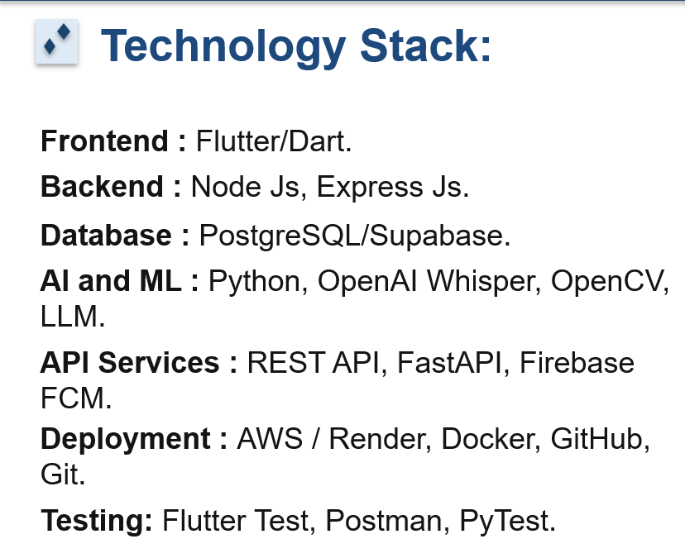
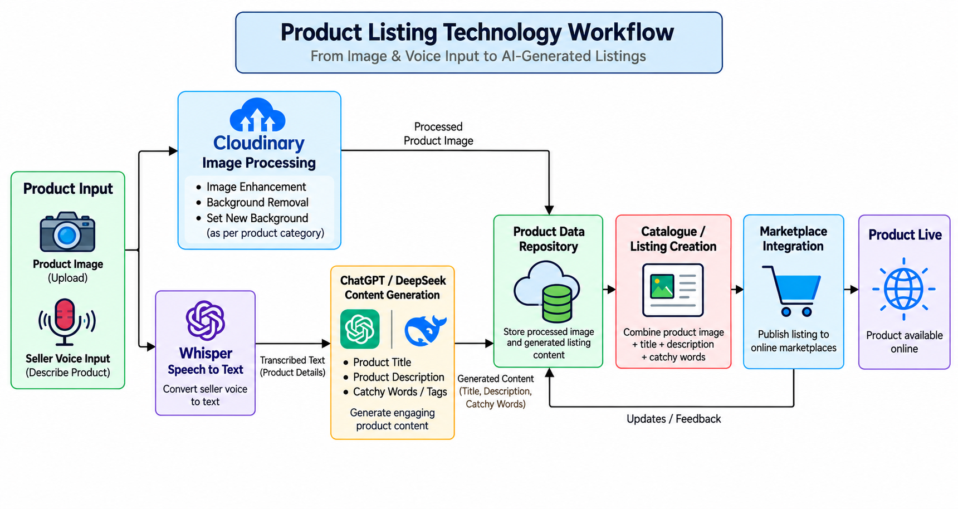

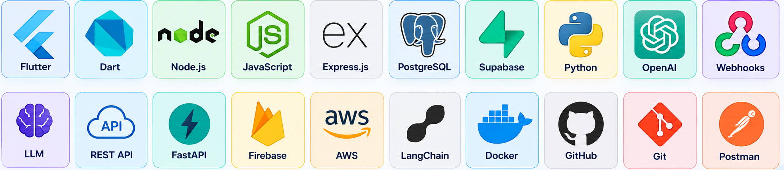
TECHNICAL APPROACH
SRIJAN
3

Slide 4
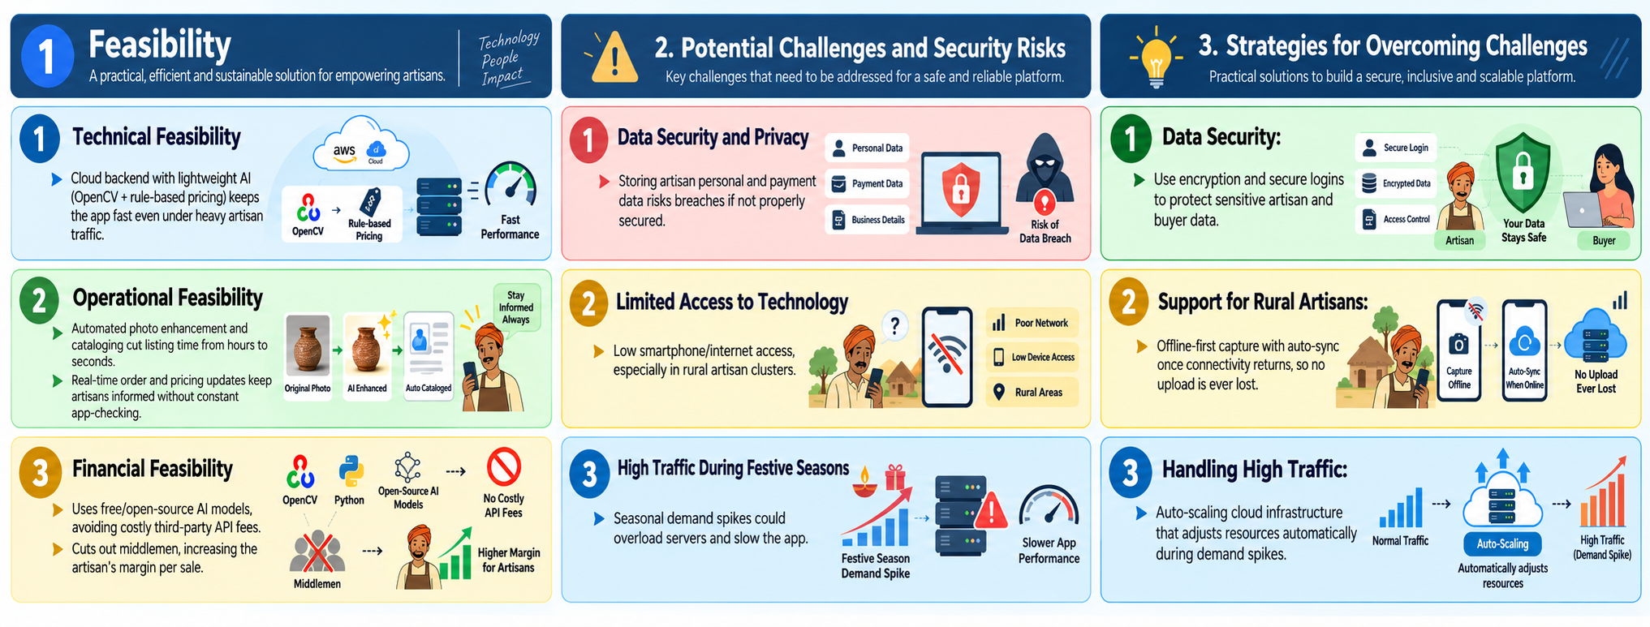
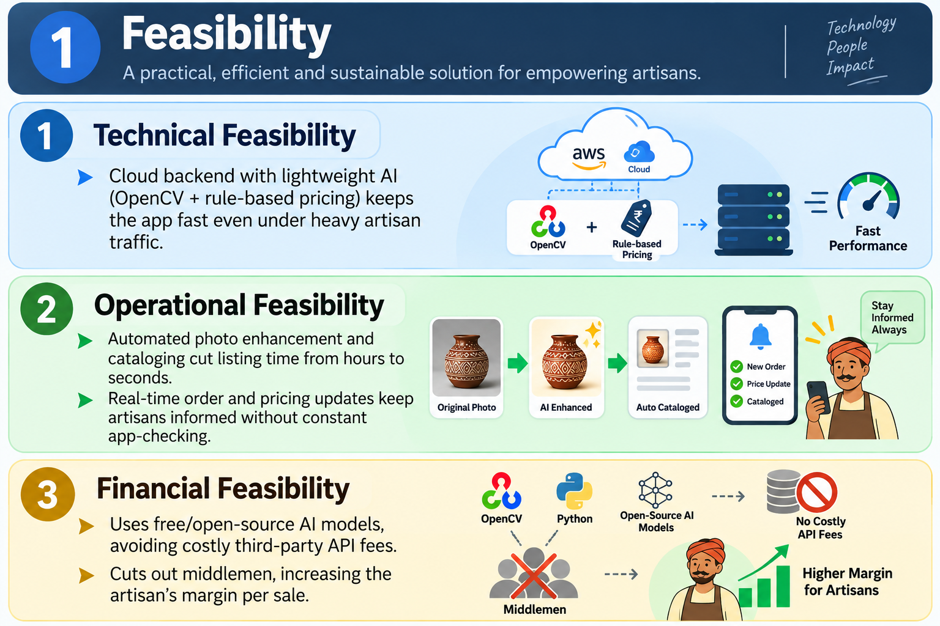
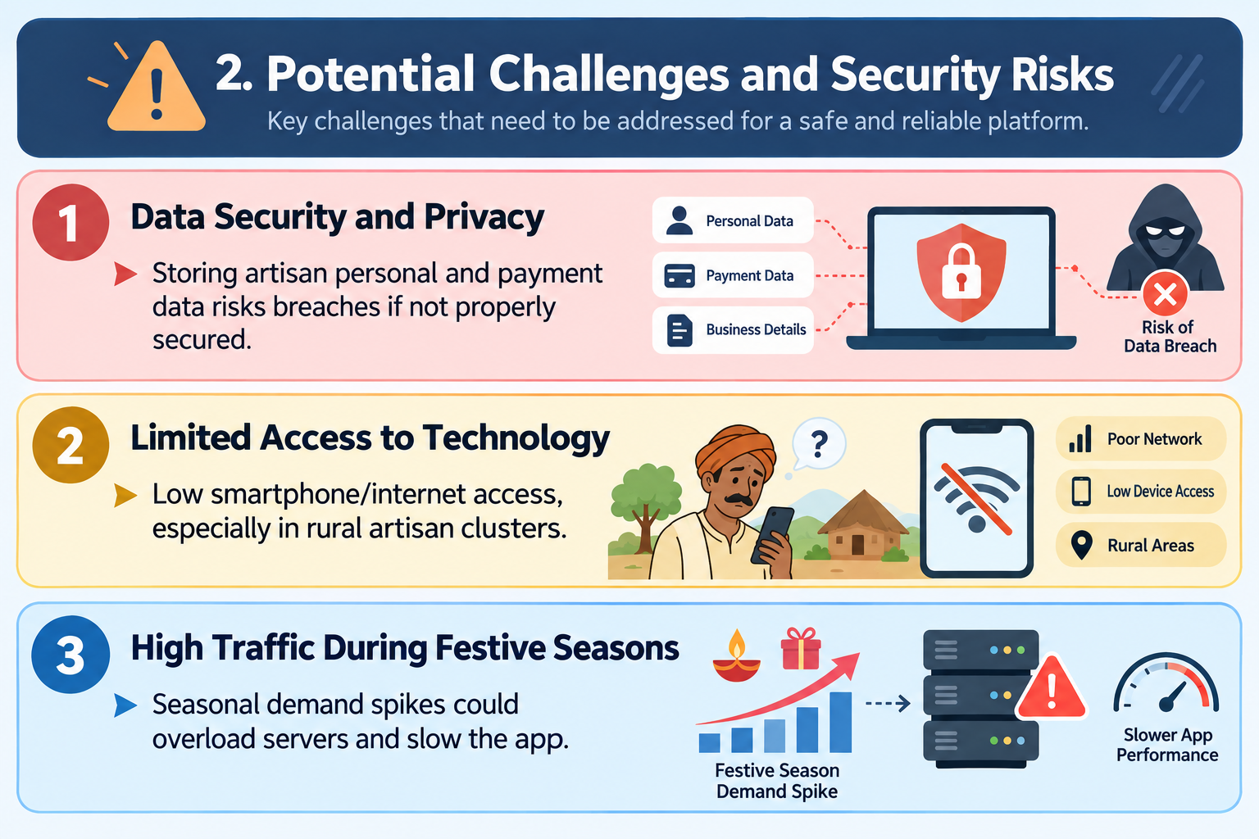
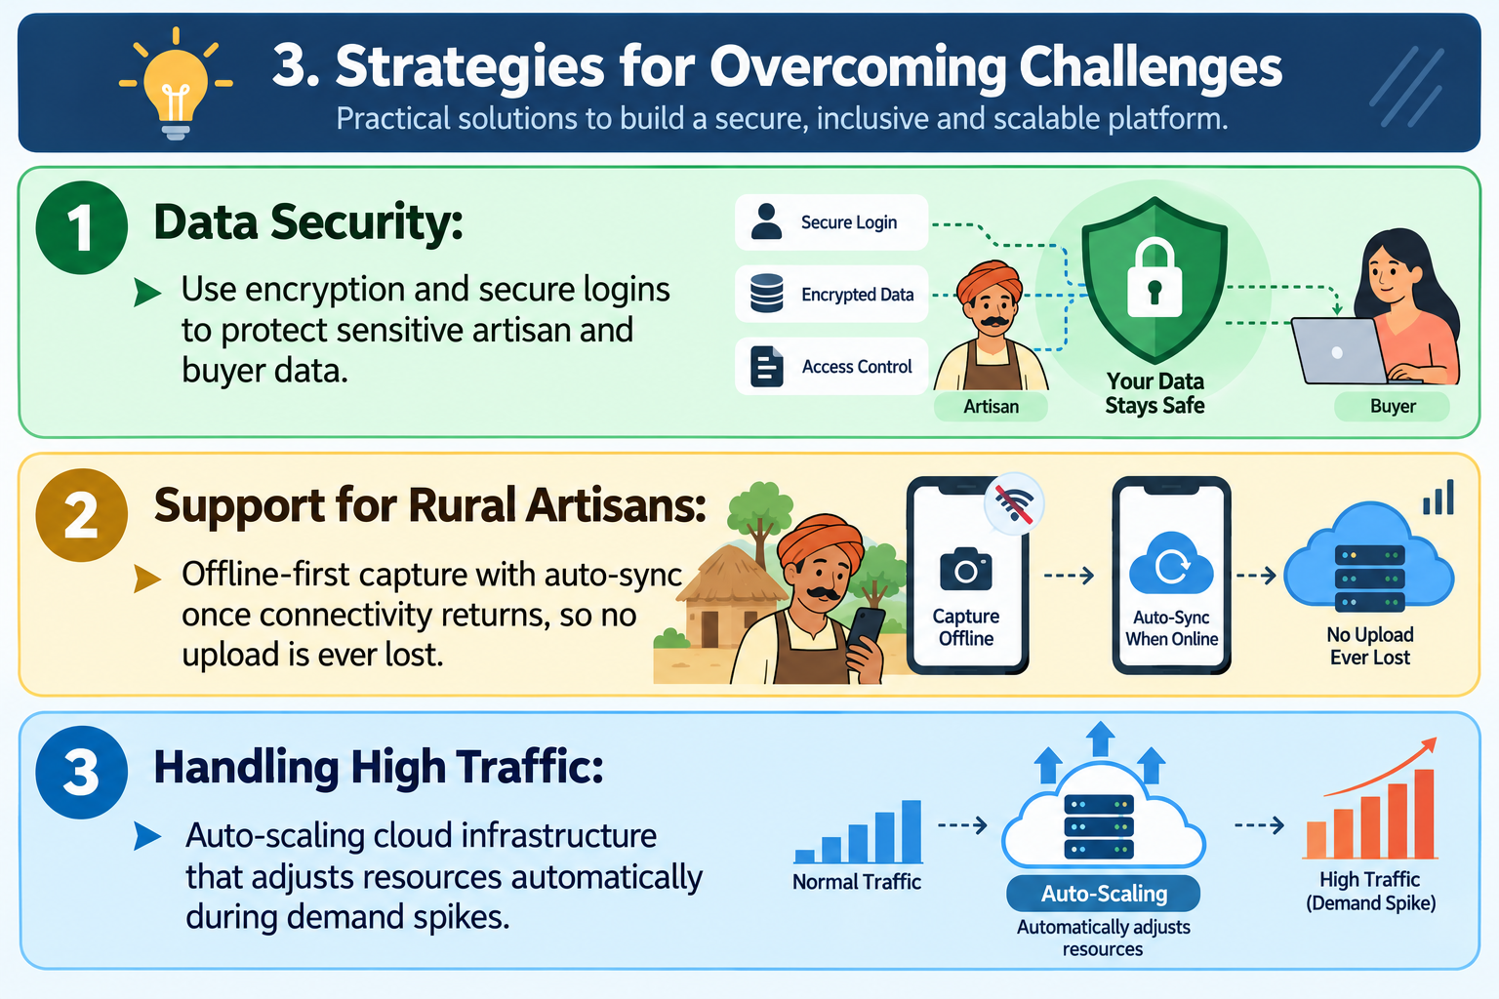
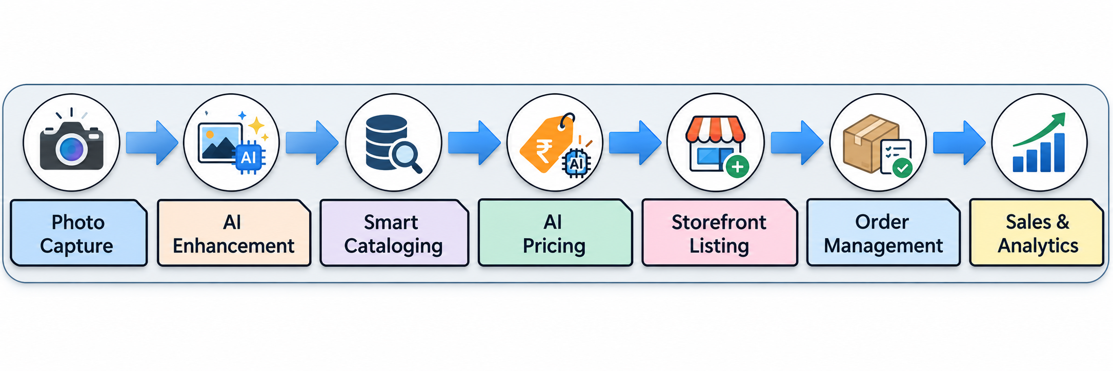
FEASIBILITY AND VIABILITY
SRIJAN
1. Feasibility
➤ Technical Feasibility
• Uses Cloudinary for image processing.
• Uses Whisper and AI models for content generation.
➤ Operational Feasibility
• Simplifies product listing creation.
• Reduces manual work for artisans.
➤ Financial Feasibility
• Uses affordable cloud-based services.
• Reduces listing and processing costs.
2. Potential Challenges & Security Risks
➤ Data Security & Privacy
• Risk of unauthorized data access.
• Privacy concerns with third-party APIs.
➤ Limited Access to Technology
• Limited digital awareness.
➤ High Traffic
• Server overload during peak seasons.
• Slow AI processing under heavy load.
3. Strategies for Overcoming Challenges
➤ Secure System Architecture
• Use encrypted API connections.
• Apply strong user authentication.
➤ Accessible User Interface
• Provide simple navigation.
• Support regional languages.
➤ Scalable Infrastructure
• Use cloud auto-scaling.
• Optimize image processing.
4

Slide 5
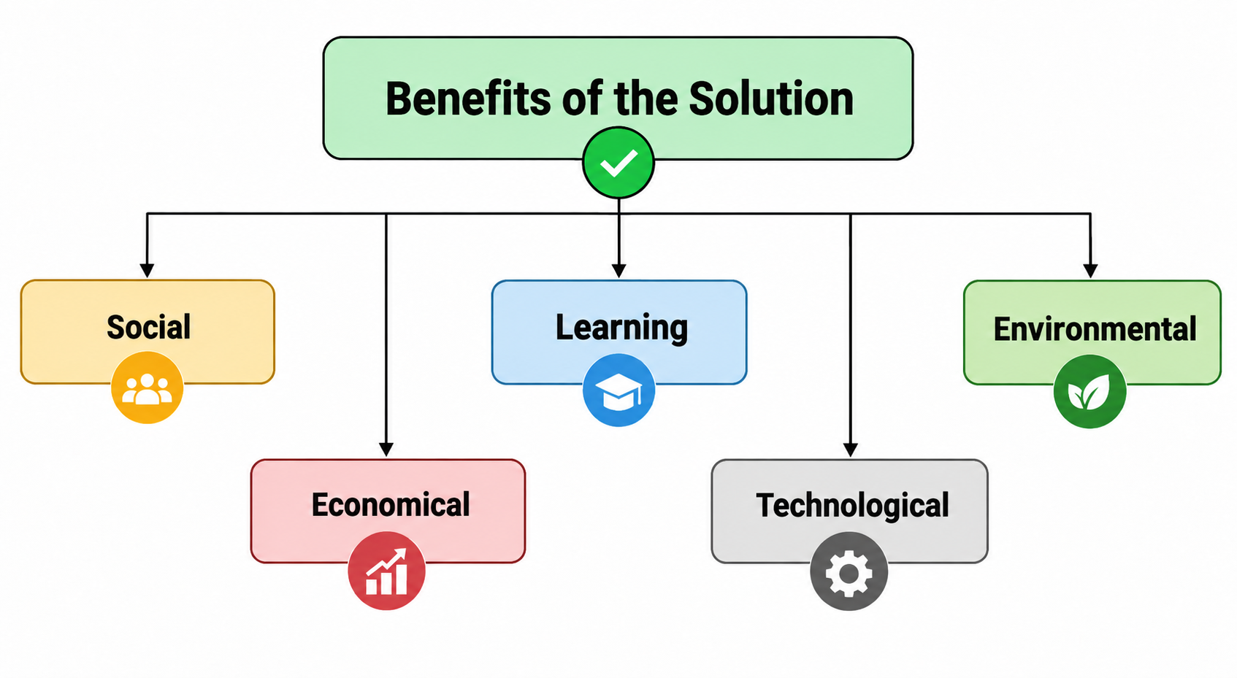
IMPACT AND BENEFITS
SRIJAN
Benefits Of the Solution:
Social:
▪ Builds dignity and a connected community for marginalized artisans across regions.
▪ Preserves traditional crafts by giving them a modern digital platform.
Economical:
▪ Provides year-round income, reducing dependence on seasonal fairs.
▪ Increases earnings by cutting out middlemen for fairer pricing.
Environmental:
▪ Reduces carbon footprint by cutting travel to physical fairs/markets through a digital storefront.
▪ Promotes low-impact production, as traditional crafts use natural, biodegradable materials and low-energy techniques.
Learning:
▪ Builds digital and financial literacy through guided, repeated use.
▪ Teaches basic e-commerce skills like cataloging and pricing.
Technological:
▪ Introduces AI-powered tools to first-time digital users.
▪ Encourages comfort with mobile technology and future innovation.
Potential Impact On The Target Audience:
➤ Removes the digital skill barrier — artisans no longer need photography, writing, or pricing expertise to sell online.
➤ Cuts out middlemen, so a larger share of each sale goes directly to the artisan.
➤ Voice-first, multilingual design brings e-commerce within reach of artisans with little to no digital literacy.
➤ Strengthens visibility for regional and traditional crafts, connecting them to buyers far beyond their local area.
5

Slide 6
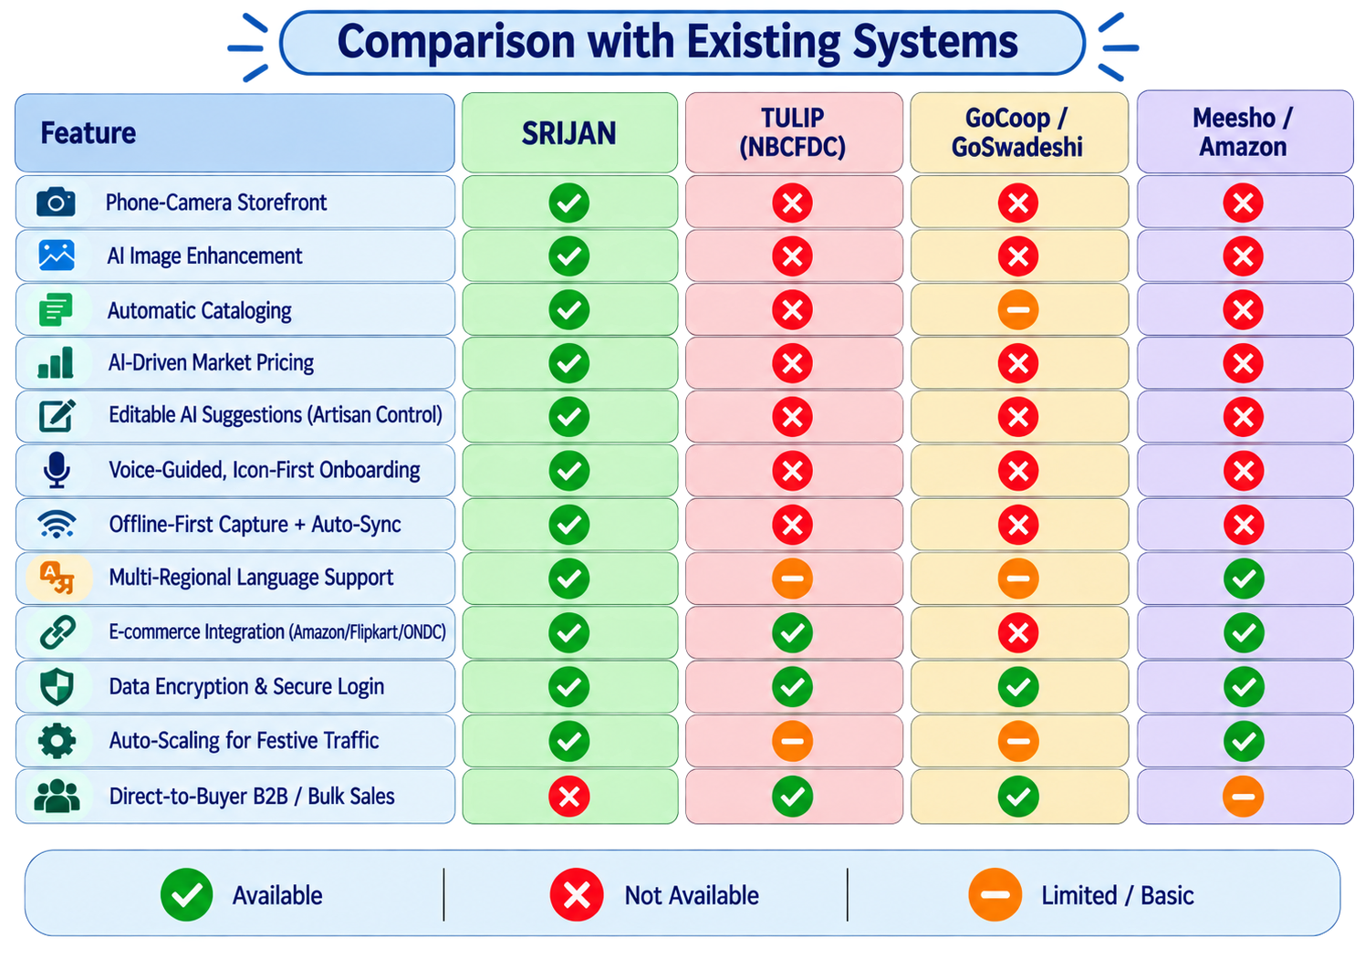
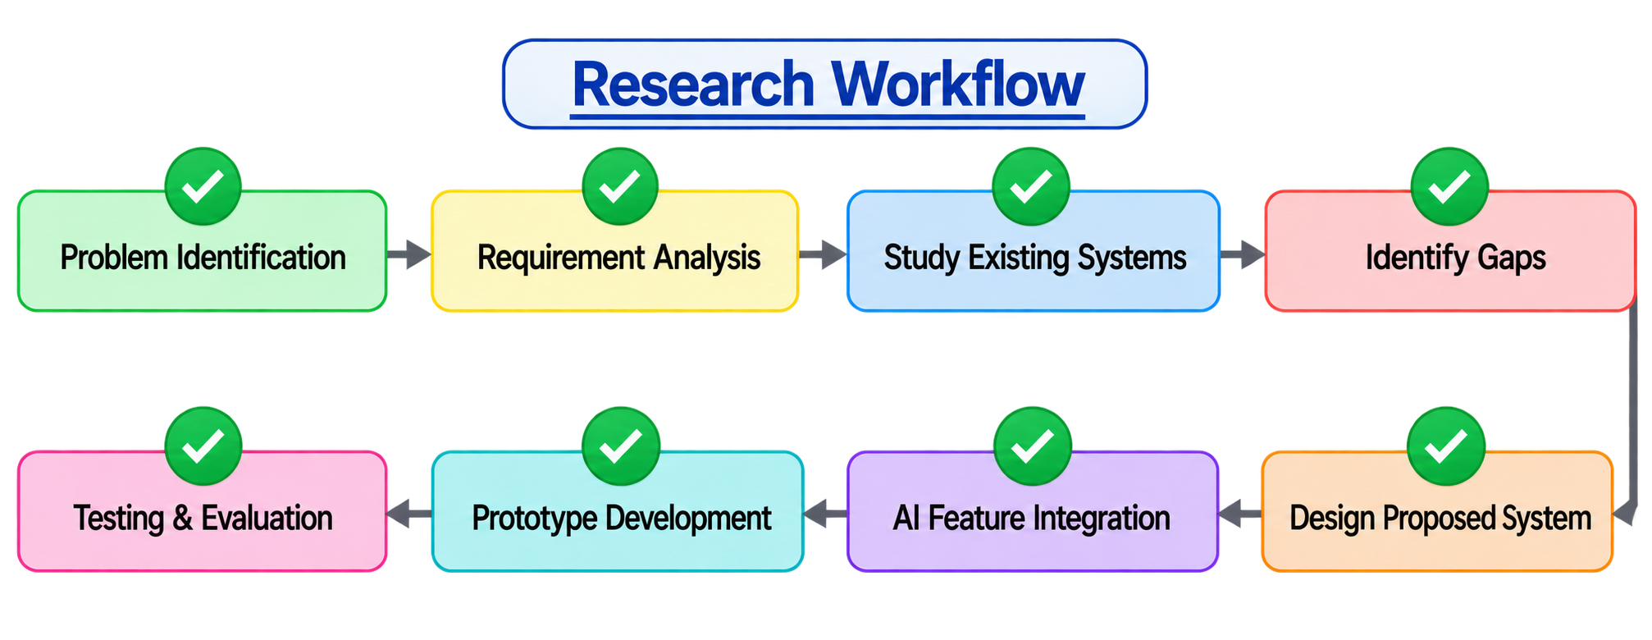
RESEARCH AND REFERENCE
SRIJAN
References:
➤ https://socialjustice.gov.in/schemes/13
➤ https://socialjustice.gov.in/schemes/100
➤ https://socialjustice.gov.in/schemes/104
➤ https://socialjustice.gov.in/schemes/99
➤ https://socialjustice.gov.in/schemes/32
6

